Slide 1
STDISCM Problem Set 2
Looking for Group - Synchronization
Kua, Miguel Carlo F.

Slide 2
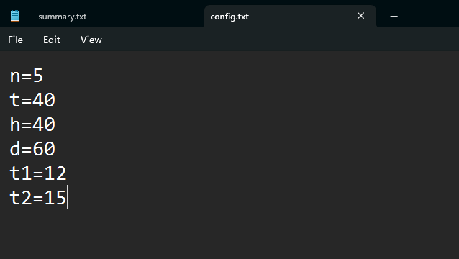
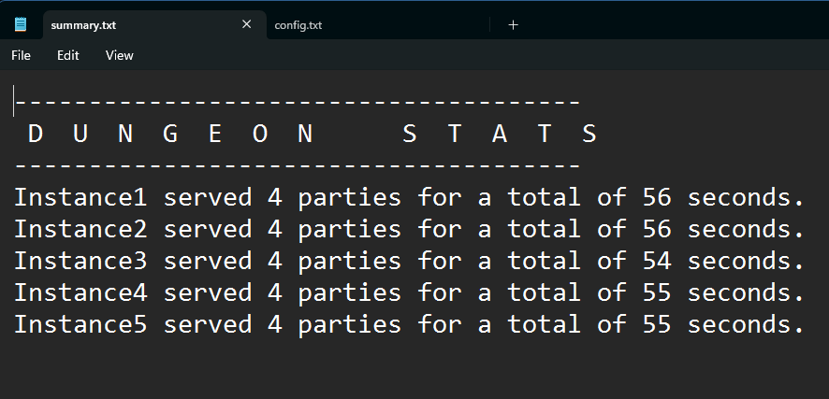
Algorithm Flow
Read through the “config.txt” file containing the parameters
Create parties through createParty()
If enough players exist, deducts 1 healer, 1 tank and 3 dps players to the player pool
Using round-robin, assign party to next available instance
Execute thread to simulate the dungeon
Once run is started, set instance to ACTIVE, whilst sleeping for random duration between t1 and t2
After the sleep duration, mark instance as EMPTY
For constant monitoring purposes, program will constantly update the instances’ status every 2 seconds
Program will end on these occasions:
Insufficient amount of players for a party
All waiting threads are notified for exit
Invalid inputs
config.txt
summary.txt

Slide 3
Deadlock and Starvation Risks
Deadlock risks
Circular waits may occur if all threads use the same mutex to proceed and none being released by them
Threads may call cv.wait(lock, condition), but the conditions never become true
Lacking a proper shutdown flag, it can lead to threads being blocked, causing a deadlock
Starvation risks
In some scenarios, when there are more DPS players but limited amount of supports or tanks, players do not have a choice but to wait longer, even in FIFO matchmaking
Without proper scheduling techniques, threads that arrive late could face a possibility of not being scheduled, creating starvation to new parties

Slide 4
Synchronization Mechanisms Used
std::mutex
used for sharing crucial data (instanceStats, player counts)
lock_guard and unique_lock functionalities were implemented to avoid race conditions
std::condition_variable
used for notifying the threads if an instance is empty or insufficient players remain to create a party
cv.notify_one() & cv.notify_all()
wakes the thread and all threads respectively
std::atomic<int>
used to safely update the amount of current active dungeons
keepRunning flag
signals the threads if no more parties can be formed

Slide 5
End of slides

